Slide 1
Snakemake
Andrew Webb

Slide 2
Our pipeline
RAW
FASTQs
Cleaned
FASTQs
Aligned
BAMs
Deduped
BAMs
VCF
fastp
BWA
sambamba
freebayes
Previously we used separate SLURM scripts to run step of our pipeline
Problems with this approach
  We had to wait for a step to finish before we could proceed
  Each script only processed a single sample
  Not taking full advantage of the HPC

Slide 3
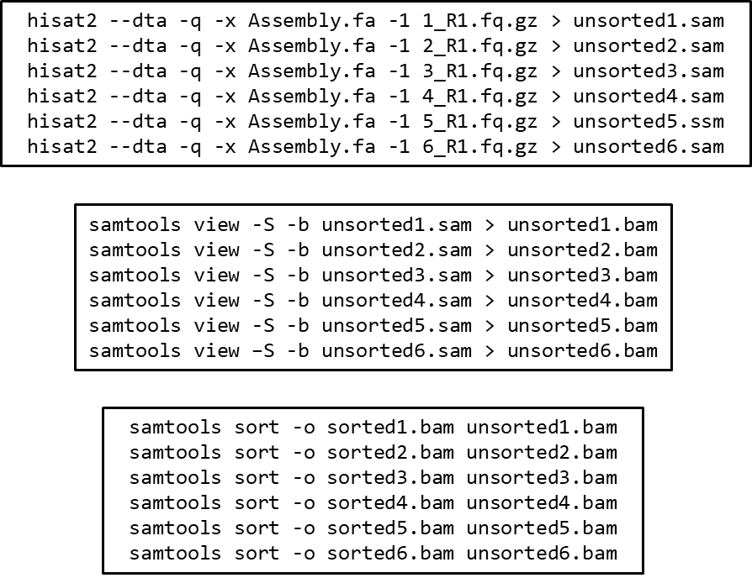
Solutions?
Long lists of commands
  Simple
  Able to run multiple samples with a single script
  Better usage of HPC systems
  Still inefficient and poorly optimized
  Difficult record keeping

Slide 4
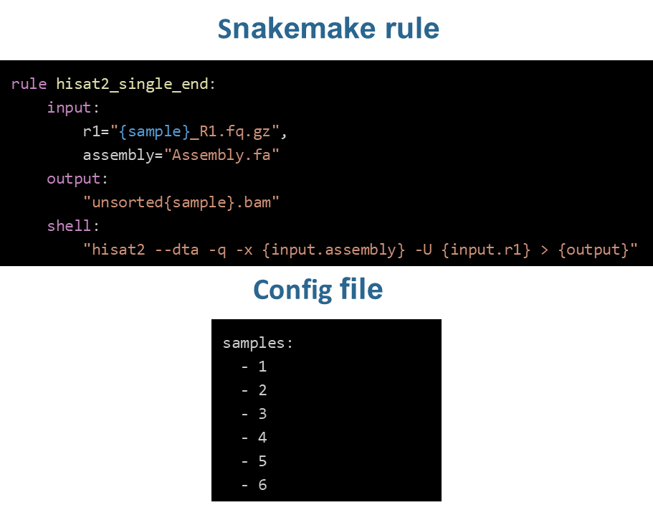
Solutions?
Snakemake
  Python-based workflow language
Consists of a set of rules with the following:
  input: file(s) that must exist for rule to run
  output: file(s) that must exist after rule runs
    If not present, will result in an error
  shell or run: operation(s) for the rule to produce the output
    shell if running a LINUX/BASH command
    run for python command
Snakemake rules finish successfully if
  The output is successfully created
  The shell/run did not result in an error

Slide 5
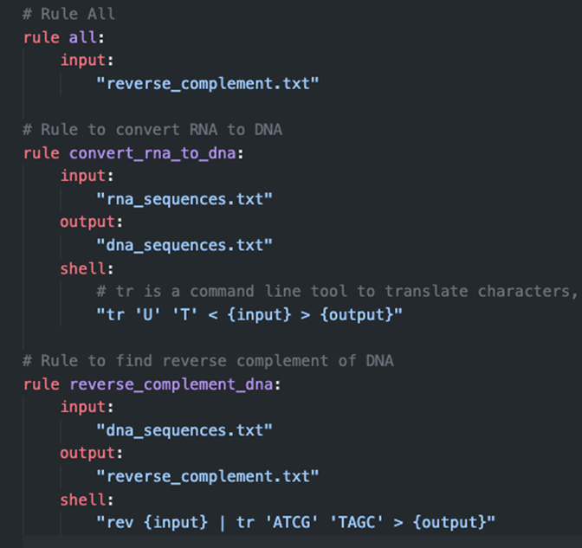
Example snakemake pipeline
A simple workflow (written by chatGPT4)
  Convert RNA sequence to DNA sequence
  Get the reverse complement of DNA sequence
How does the pipeline know what to create?
  rule all:
  Typically written towards top of file
  Defines the final input of the pipeline
  Snakemake will determine the rules needed (and order) to produce the file(s)

Slide 6
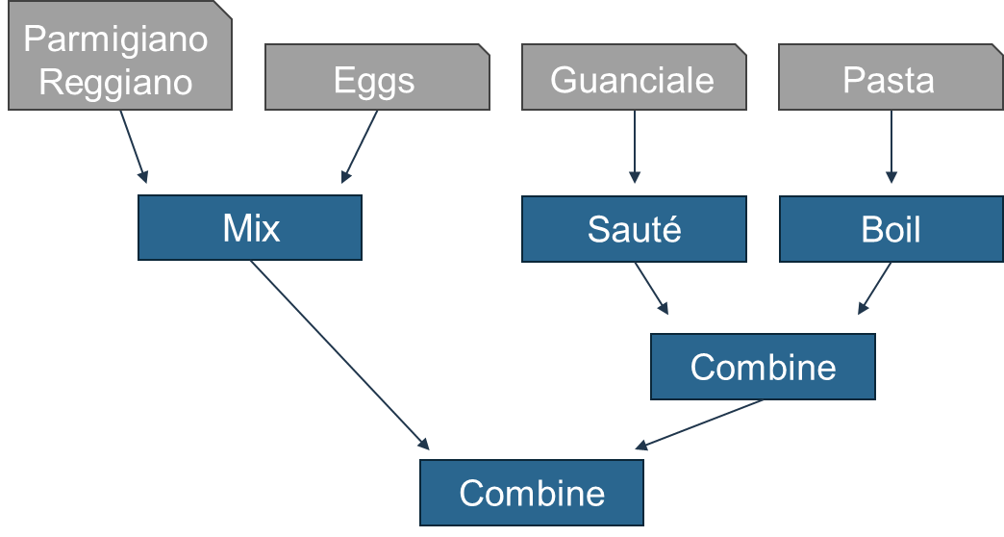
Snakemake as pasta

Slide 7
Cluster example

Slide 8
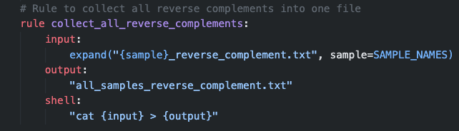
Snakemake – Wildcards
Wildcards allow snakemake to process lists
  Multiple samples
  Different species
Snakemake uses wildcards to
  Perform rules on each samples or species
  Expand a rule to operate on all samples/species
SAMPLE_NAMES
  List of sample names

Slide 9
Cluster example

Slide 10
Our pipeline
RAW
FASTQs
Cleaned
FASTQs
Aligned
BAMs
Deduped
BAMs
VCF
fastp
BWA
sambamba
freebayes
Analyses
Ancestry estimation
PCA
GWAS
ADMIXTURE
plink
gemma

Slide 11
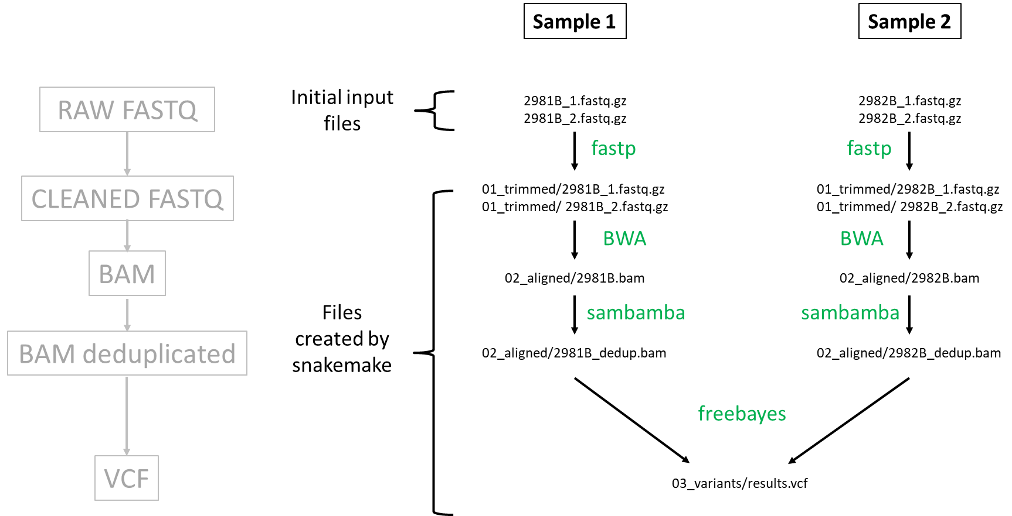
Snakemake pipeline

Slide 12
Cluster example

